Slide 1
Introduction to Probability
Sang-Phil Kim

Slide 2
What is Probability
A measure of likelihood

Slide 3
Uncertainties
Lack of certainty
A state of limited knowledge
Impossible to exactly describe
More than one possible outcome

Slide 4
Random Experiment and Its Sample Space
Random experiment : a process that generates well-defined experimental outcomes.
Outcome : result of experiment
Sample space : the set of all possible outcomes.
Event : Any collection of outcome

Slide 5
Random Experiment and Its Sample Space
Experiment
Toss a coin
Toss a coin twice
Conduct a sales call
Roll a die
Play a game
Experiment Outcomes
(Sample Space)
{Head, Tail}
{HH, HT, TH, TT}
{Purchase, No purchase}
{1, 2, 3, 4, 5, 6}
{Win, Lose, Tie}

Slide 6
Probability
Probability is a numerical measure of the likelihood that an event will occur.
Probability values are always assigned on a scale from 0 to 1.
Probability:
0
.5
1
The event is very unlikely to occur.
The event
is almost
certain
to occur.
The occurrence
of the event is
just as likely as
it is unlikely.

Slide 7
Assigning Probabilities I
How to measure the likelihood

Slide 8
Assigning probabilities to Events
Classical Method
a priori Method
Empirical Method
Subjective Method

Slide 9
a priori Probability
Based on the assumption of equally likely outcomes
P(Event) = x/N
x : number of outcomes favoring the event
N : total number of outcome in the sample space
Required prior knowledge of the process
Example
Rolling a die,
Event A : getting 2 or less
P(A) =

Slide 10
Empirical Method
Based on experimentation or historical data
P(Event) = x/N
x : number of experiments
N : total number of outcome observed
Also called relative frequency method
Example
Out of 100 parts, two are defective.
P(defective part) =

Slide 11
Subjective Method
Used when economic conditions or a company’s circumstance change rapidly (historical data alone is inappropriate)
Experiment is not possible
Based on experience and intuition.
Often combined with classical methods

Slide 12
Assigning Probabilities II
Event and probabilities

Slide 13
Requirements of Probabilities
The probability assigned to each experimental outcome must be between 0 and 1, inclusively.
The sum of the probabilities for all outcomes must equal 1.
0 < P(E_{i}) < 1 for all i
where: E_{i} is the i^{th} experimental outcome and P(E_{i}) is its probability
P(E₁) + P(E₂) + . . . + P(E_{n}) = 1

Slide 14
Events and Their Probabilities
An event is a collection of sample points.
The probability of any event is equal to the sum of the probabilities of the sample points in the event.
If we can identify all the sample points of an experiment and assign a probability to each, we can compute the probability of an event.

Slide 15
Events and Probabilities (example)
When we roll two dice
Event : The sum of two dice is greater than 8
Sample points in the event
(3,6) (4,5) (4,6) (5,4) (5,5) (5,6) (6,3) (6,4) (6,5) (6,6)
Total possible outcome = 6×6=36
The probability of the event = 10/36 = 5/18

Slide 16
Events and Probabilities (Example)
The Soccer betting experts expect that
Event : Team A wins
Probability of the Event : .37+.17+.14+.07 = 0.75
Team A score | Team B score | Winner | Probability
2 | 1 | A | 37%
3 | 2 | A | 17%
2 | 0 | A | 14%
3 | 1 | A | 7%
1 | 2 | B | 9%
1 | 1 | Draw | 16%

Slide 17
Counting
Factorial, Permutation and Combination

Slide 18
Factorial
Factorial of N denoted by N!
The number of different way to arrange N objects
Number of different order of N objects
N ! = N×(N-1) ×… ×2 ×1
0 ! = 1

Slide 19
Factorial (example)
Tom has 5 Avengers miniature action figures, Ironman, Spiderman, Caption America, Hulk, and Thor. He wants to rank and display according to popularity.
How many different way can Tom rank them in?
ISCHT, SCIHT,…..
1
2
3
4
5

Slide 20
Quiz – Challenge
In Avengers problem, how many different way to arrange with Ironman & Spiderman next to each other?
How many unique ways are there to arrange the letters in the word PRIOR?

Slide 21
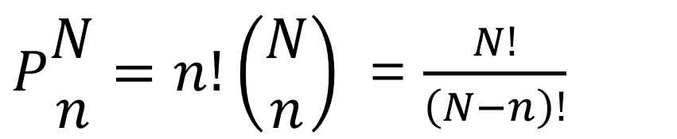
Permutations
the number of experimental outcomes when n objects are to be selected from a set of N objects, when the order of selection matters.
$P\begin{matrix}N \\ n\end{matrix}=n!\left(\begin{matrix}N \\ n\end{matrix}\right)$ = $\frac{N!}{\left(N−n\right)!}$
= N×(N-1) ×(N-2) × … ×(N-n+1)

Slide 22
Permutations (Example)
An elementary school teacher, Mary has to choose three of her students as assistants for PE, Music and Art classes, separately. If she has 15 students in her class, how many different way to choose three students?
PE
Music
Art

Slide 23
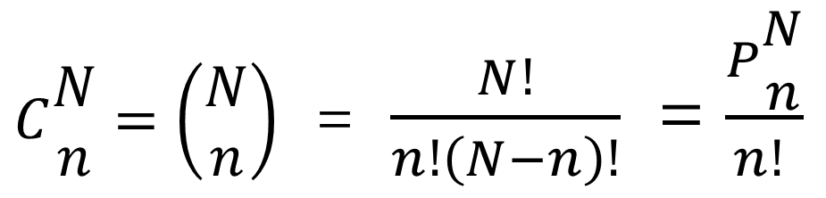
Combinations
the number of experimental outcomes when n objects are to be selected from a set of N objects. (Order doesn’t matter)
$C\begin{matrix}N \\ n\end{matrix}=\left(\begin{matrix}N \\ n\end{matrix}\right)$ = $\frac{N!}{n!\left(N−n\right)!}$ = $\frac{P\begin{matrix}N \\ n\end{matrix}}{n! }$

Slide 24
Combinations (Example)
An elementary school teacher, Mary has to choose three of her students as assistants for PE, Music and Art classes, But they will work as a team. They will help together one class at a time. If she has 15 students in her class, how many different way to choose three students?

Slide 25
Quiz – Challenge
If you flip a fair coin 4 times, what is the probability that you will get exactly 2 tails?
There are 8 students in a class: 2 boys and 6 girls. If the teacher picks a group of 5 at random, what is the probability that everyone in the group is a girl?
(From Khan Academy)

Slide 26
Relationships of Probabilities
Complement, Union, Intersection and Mutually exclusive

Slide 27
Complement of an Event
Complement of event A : All points which is NOT A
The complement of A : A^{c}
P(A) = 1 – P(A^{c})
A^{c}
A
Sample
Space S

Slide 28
Union of Two Events
The union of events A and B is the event containing all sample points that are in A or B or both.
The union of events A and B : A ∪ B.
Event A
Event B

Slide 29
Union of Two Events
Total 50 students
Boy : 27, Basketball players :15
Boy Basketball players : 10
If we select one student randomly, what is the probability that the student is either Boy or Basketball player?

Slide 30
Additional Law
The addition law provides a way to compute the probability of event A, or B, or both A and B occurring.
The law is written as:
P(A ∪ B) = P(A) + P(B) − P(A ∩ B)

Slide 31
Intersection of Two Events
The intersection of events A and B is the set of all sample points that are in both A and B.
The intersection of events A and B is denoted by A ∩ B.
Intersection of A and B
Sample
Space S
Event A
Event B

Slide 32
Intersection of Two Events
Total 50 students
Boy : 27, Basketball players :25
The student who is either Boy or Basketball player : 35
If we select one student randomly, what is the probability the student is Boy and Basketball player?

Slide 33
Mutually Exclusive
Two events are said to be mutually exclusive if the events have no sample points in common.
That means if one event occurs, the other cannot occur.
Sample
Space S
Event A
Event B

Slide 34
Mutually Exclusive Events
A and B are mutually exclusive, P(A ∩ B) = 0.
The addition law for mutually exclusive events
P(A ∪ B) = P(A) + P(B)

Slide 35
Mutually Exclusive
Total 50 students
Boy : 27, Basketball players :15
Boy Basketball players : 0 (Mutually Exclusive)
If we select one student randomly, what is the probability that the student is either Boy or Basketball player?

Slide 36
Monty Hall Problem
Probability Tree

Slide 37


Explained by Kevin Spacey in the movie, 21

Slide 38

Monty Hall Problem
Switch or Stay?
1) Stay would have a higher probability to win.
2) Switch would have a higher probability to win.
3) It doesn’t matter. 50/50 chance.

Slide 39

Ben’s Answer

Slide 40
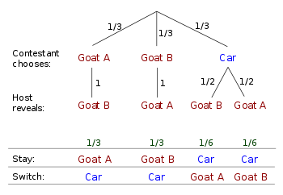
Probability Tree

Slide 41
In other words,
We can see if your first choice was a car, you have to stay, and if your first choice was a goat, you should switch.
Now, what is the probability that your first choice was a car?

Slide 42
Conditional Probability
Additional information

Slide 43
Joint Probability
Event | Event |  | Total
 | C | D
A | P(A and C) | P(A and D) | P(A)
B | P(B and C) | P(B and D) | P(B)
Total | P(C) | P(D) | 1
Marginal (Simple) Probability
Joint Probability

Slide 44
Joint Probability
Event | Event |  | Total
 | C | D
A | 4 | 2 | 6
B | 1 | 3 | 4
Total | 5 | 5 | 10
P(A) =
P(B and C) =
P(A or D) =

Slide 45
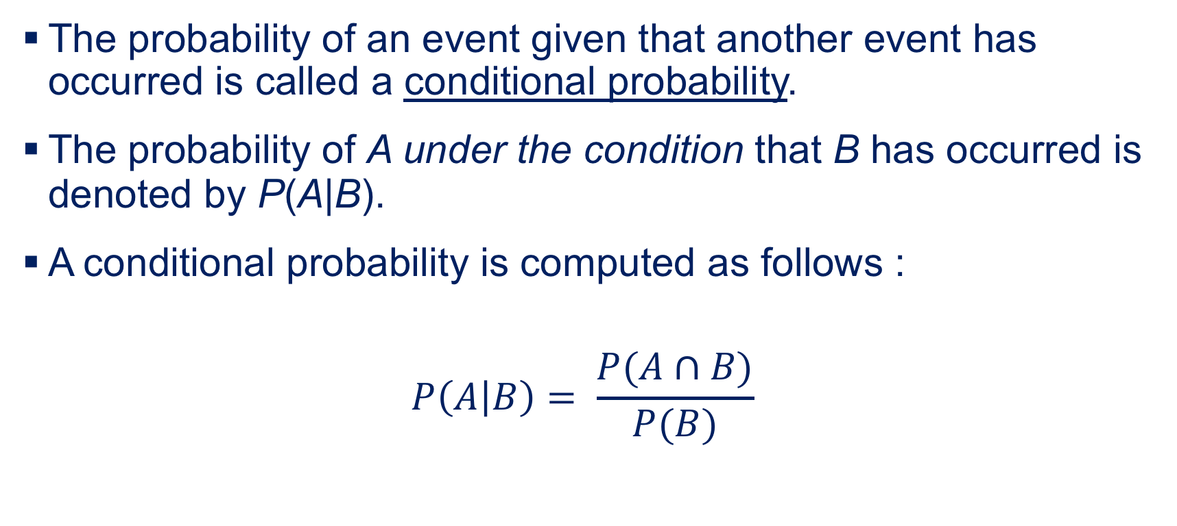
Conditional Probability
The probability of an event given that another event has occurred is called a conditional probability.
The probability of A under the condition that B has occurred is denoted by P(A|B).
A conditional probability is computed as follows :
$$P\left(A | B\right)= \frac{P(A∩B)}{P(B)}$$

Slide 46
Conditional Probability
Number of events observed
P(A|D) =
P(C|B) =
Event | Event |  | Total
 | C | D
A | 4 | 2 | 6
B | 1 | 3 | 4
Total | 5 | 5 | 10

Slide 47
Multiplication Law
The multiplication law provides a way to compute the probability of the intersection of two events.
P(A ∩ B) = P(B)P(A|B)
or
P(A ∩ B) = P(A)P(B|A)

Slide 48
Multiplication Law
Revisit the previous example
P(A and D) = P(A ∩ D)=
P(B and C) = P(B ∩ C)=
Event | Event |  | Total
 | C | D
A | 4 | 2 | 6
B | 1 | 3 | 4
Total | 5 | 5 | 10

Slide 49
Independent Events
If the probability of event A is not changed regardless of the result of event B, we would say that events A and B are independent.
P(A|B) = P(A) or P(B|A) = P(B)

Slide 50
Multiplication Law for Independent Events
The multiplication law also can be used as a test to see if two events are independent.
P(A ∩ B) = P(A)P(B)

Slide 51
Multiplication Law for Independent Events
Event | Event |  | Total
 | C | D
A | 3 | 6 | 9
B | 2 | 4 | 6
Total | 5 | 10 | 15
P(A)=
P(A|C) =
P(A and C) =

Slide 52
Mutual Exclusiveness and Independence
Mutual exclusive events cannot be independent.
Mutually exclusive A & B
P(A∩B)= 0
P(A∪B) =P(A)+P(B)
P(A∣B) = 0
Independent A & B
P(A∩B)= P(A)P(B)
P(A∪B) =P(A)+P(B)- P(A)P(B)
P(A∣B) = P(A)
P(B|A) = P(B)

Slide 53
Bayes’ Theorem
Updating the probability after new information

Slide 54
After new Information,
1% of women have breast cancer
80% of mammograms detect breast cancer when there is cancer
9.6% of mammograms detect breast cancer when there is NOT cancer
The test result turns out to be positive. What is the probability that the patient indeed has breast cancer?

Slide 55
Bayes’ Theorem
Before the test, the patient’s chance to have cancer = 1%
➜ Prior Probability (= 0.01)
After the positive test result, the probability of cancer must be higher than 1%
➜ Posterior Probability (= How much?)
Prior
Probabilities
New
Information
Application
of Bayes’
Theorem
Posterior
Probabilities

Slide 56
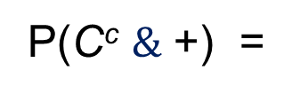
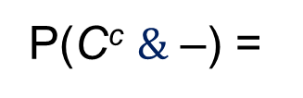
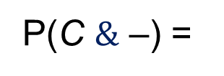

Tree Diagram
Cancer or not
Test result
Outcomes
P(+|C^{c}) = .096
P(C^{c} $\&$ +) =
P(C^{c}) = .99
P(–|C^{c}) = .904
P(C^{c} $\&$ –) =
P(+|C) = .8
P(C $\&$ +) =
P(C) = .01
P(C $\&$ –) =
P(–|C) = .2

Slide 57
Bayes’ Theorem
Event | Test |  | Total
 | Positive | Negative
Cancer |  |  | 1%
No cancer |  |  | 99%
Total |  |  | 100%
When the test result turns out to be positive, what is the probability that the patient indeed has breast cancer? (Posterior Probability)
P(Cancer|Positive) =

Slide 58
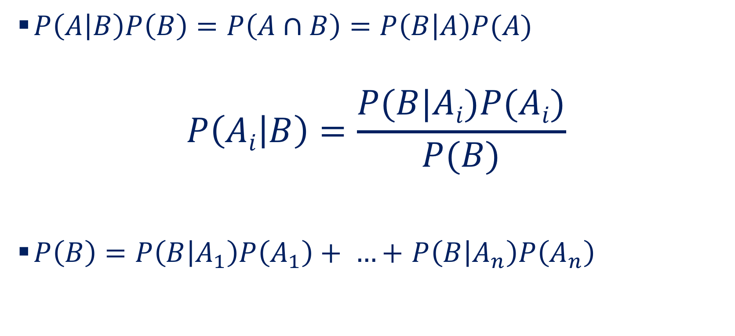
Bayes’ Theorem
$P\left(A | B\right)P\left(B\right)=P\left(A∩B\right)=P\left(B | A\right)P(A)$
$$P\left(Ai | B\right)=\frac{P(B|Ai)P(Ai)}{P(B)}$$
$P\left(B\right)=P\left(B | A_{1}\right)P\left(A_{1}\right)+ …+$ $P\left(B | A_{n}\right)P\left(A_{n}\right)$

Slide 59




















Prior
P( ) =
Posterior
P( ) =
The figures are Not in scale.

Slide 60
Bayes’ Theorem – Example

Slide 61
Example : New product
ICICLE, a frozen food company, develops a new frozen food product.
The new frozen food product can be
A₁ : a failure in the real market
A₂ : a marginal success in the real market
A₃ : a major success in the real market
Before introducing the new product to the real market, ICICLE has an option to test it in a test market.

Slide 62
Prior Probabilities
It is known from the past experience with similar products or based on management’s judgement, that
P(A₁) = 0.8
P(A₂) = 0.15
P(A₃) = 0.05.
These probabilities are Prior Probabilities

Slide 63
Test Market – New information
Possible outcomes from test market are
B₁ : a small test market share
B₂ : a large test market share
According to historical information
2% of product failures(A₁) had a large test market share(B₂).
24% of marginal successes(A₂) had a large test market share(B₂).
98% of major successes(A₃) had a large test market share(B₂)

Slide 64
New Information
The test market turned out to be large test market share.
Now what is the probability that the new product will be a major success in the real market after the test market result?
P(A₃|B₂) = ?

Slide 65
Conditional Probabilities
What we know
P(A₁) = 0.8, P(A₂) = 0.15, P(A₃)=0.05. Prior Probability
P(B₂|A₁) = 0.02 , P(B₂|A₂) = 0.24, P(B₂|A₃) = 0.98

Slide 66
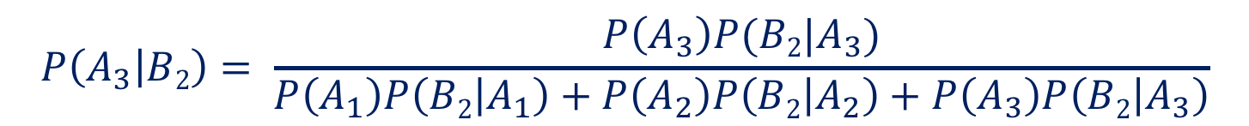
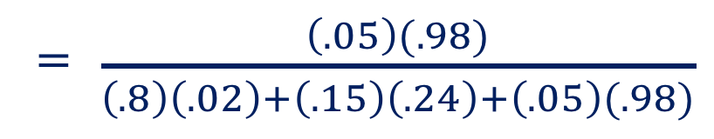
Posterior Probabilities
Given the test market result is large test market share, we revise the prior probabilities as follows:
$$P\left(A_{3} | B2\right)= \frac{P\left(A_{3}\right)P(B2|A_{3})}{P\left(A_{1}\right)P\left(B2 | A_{1}\right)+P\left(A_{2}\right)P\left(B2 | A_{2}\right)+P\left(A_{3}\right)P\left(B2 | A_{3}\right)}$$
= $\frac{\left(.05\right)(.98)}{\left(.8\right)\left(.02\right)+\left(.15\right)\left(.24\right)+\left(.05\right)(.98)}$

Slide 67
Posterior Probabilities
The large test market share is good news for ICICLE.
The posterior probability of a major success in real market is 0.485(48.5%) compared to a prior probability of 0.05(5%).

Slide 68
Bayes’ Theorem – Tabular Approach

Slide 69
Bayes’ Theorem: Tabular Approach
The ICICLE example
P(B₂|A₁) = 0.02 , P(B₂|A₂) = 0.24, P(B₂|A₃) = 0.98
Real market | Test Market |  | Total
 | B₁ | B₂
A₁ | P(A₁&B₁) |  | 0.80
A₂ |  | P(B₂|A₂)P(A) | 0.15
A₃ | P(B₂|A₂)P(A) | P(A₃&B₂) | 0.05
Total |  |  | 1.00

Slide 70
Bayes’ Theorem: Tabular Approach
The ICICLE example
P(B₂|A₁) = 0.02 , P(B₂|A₂) = 0.24, P(B₂|A₃) = 0.98
Real market | Test Market |  | Total
 | B₁ | B₂
A₁ |  |  | 0.80
A₂ |  |  | 0.15
A₃ |  |  | 0.05
Total |  |  | 1.00

Slide 71
Bayes’ Theorem: Tabular Approach
The ICICLE example
P(B₂|A₁) = 0.02 , P(B₂|A₂) = 0.24, P(B₂|A₃) = 0.98
Real market | Test Market |  | Total
 | B₁ | B₂
A₁ | 0.784 | 0.016 | 0.80
A₂ | 0.114 | 0.036 | 0.15
A₃ | 0.001 | 0.049 | 0.05
Total | 0.899 | 0.101 | 1.00

Slide 72
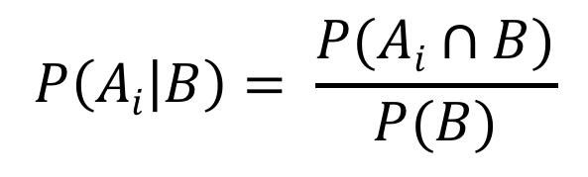
Bayes’ Theorem: Tabular Approach
P(A₃∩B₂) = 0.049
P(B₂) = 0.101
P(A₃|B₂) = 0.049/0.101 = 0.485
$$P\left(Ai | B\right)= \frac{P(Ai∩B)}{P(B)}$$

Slide 73
Discrete Probability Distribution
Expected Value and Variance

Slide 74
Random Variables
Numerical outcome of random phenomenon
Discrete or Continuous
Discrete random variable has a countable number of possible values. e.g. The sum of two dice.

Slide 75
Discrete Probability Distribution
List of all possible pairs of (x_{i}, f(x_{i}))
Where x_{i} = a value of the random variable X f(x_{i}) = Probability of getting value of x_{i}
f(x_{i}) : Probability Mass Function
Condition for the probability mass function
0 ≤ f(x_{i}) ≤ 1
∑_{i} f(x_{i}) = 1

Slide 76
Sum of two dice
x_{i} | f(x_{i})
2 | 1/36
3 | 2/36
4 | 3/36
5 | 4/36
6 | 5/36
7 | 6/36
8 | 5/36
9 | 4/36
10 | 3/36
11 | 2/36
12 | 1/36
Sum | 36/36 = 1
f(x_{i})
x_{i}

Slide 77
Expected Value
Mean of probability distribution for the random variable
Weighted average of all the possible values
Probability → weight
Expected value of a discrete random variable X
E(X) = 𝜇 = ∑_{i} x_{i} f(x_{i})

Slide 78
Expected Value of the sum of two dice
x_{i} | f(x_{i}) | x_{i} f(x_{i})
2 | 1/36 | 2/36
3 | 2/36 | 6/36
4 | 3/36 | 12/36
5 | 4/36 | 20/36
6 | 5/36 | 30/36
7 | 6/36 | 42/36
8 | 5/36 | 40/36
9 | 4/36 | 36/36
10 | 3/36 | 30/36
11 | 2/36 | 22/36
12 | 1/36 | 12/36
Sum | 36/36 = 1 | 252/36 = 7
f(6) = 5/36
(1,5), (5,1), (2,3), (3,2), (3,3)
E(X) = 7

Slide 79
Variance
Weighted average of squared deviation from the mean
Variance of a discrete random variable X
Var(X) = 𝜎² = E [ (X-𝜇)² ] = ∑_{i} (x_{i} -𝜇 )²f(x_{i})

Slide 80
Variance of the sum of two dice
x_{i} | f(x_{i}) | x_{i} f(x_{i}) | (x_{i} – E(X))² | (x_{i} – E(X))²f(x_{i})
2 | 1/36 | 2/36 | (2-7)²=25 | 25/36
3 | 2/36 | 6/36 | 16 | 32/36
4 | 3/36 | 12/36 | 9 | 27/36
5 | 4/36 | 20/36 | 4 | 16/36
6 | 5/36 | 30/36 | 1 | 5/36
7 | 6/36 | 42/36 | 0 | 0/36
8 | 5/36 | 40/36 | 1 | 5/36
9 | 4/36 | 36/36 | 4 | 16/36
10 | 3/36 | 30/36 | 9 | 27/36
11 | 2/36 | 22/36 | 16 | 32/36
12 | 1/36 | 12/36 | 25 | 25/36
Sum | 36/36 = 1 | 252/36 = 7 |  | 210/36 = 5.833

Slide 81
Discrete Probability Distribution
Poisson distribution
Bernoulli distribution
Binomial distribution
Geometric distribution
Negative Binomial distribution
Discrete Uniform distribution

Slide 82
Binomial Distribution

Slide 83
Binomial random variable
Number of successes in a sequence of n independent experiments.
In each experiment, the possible outcome is binomial
(0,1), (Success, Failure), (Head, Tail), etc.
The probability of success : p
The number of trials : n

Slide 84
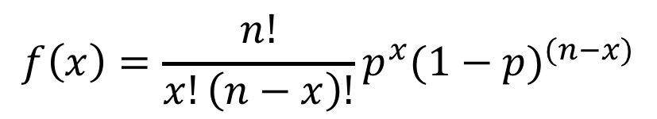
Binomial Probability Distribution
Binomial Probability Mass Function
$$f\left(x\right)=\frac{n!}{x!\left(n−x\right)!}p^{x}(1−p)^{(n−x)}$$
where:
x = the number of successes
p = the probability of a success on one trial
n = the number of trials
f(x) = the probability of x successes in n trials
n! = n(n – 1)(n – 2) ….. (2)(1)

Slide 85
Toss a coin
If you toss a unfair coin, (probability of head = 0.7) three times,
The probability of two tails or one head
HTT case 0.7 × 0.3 × 0.3 = 0.063
THT case 0.3 × 0.7 × 0.3 = 0.063
TTH case 0.3 × 0.7 × 0.3 = 0.063
P(H=1)=P(T=2) = 3 × 0.063 = 0.189

Slide 86
Example : Automotive part
A company supplies a part to automotive manufacturers.
Each produced part has a chance to be defective with the probability 5% (0.05).
If the company produces 10 items,
What is the probability that the number of non-defective items are exactly 9?

Slide 87
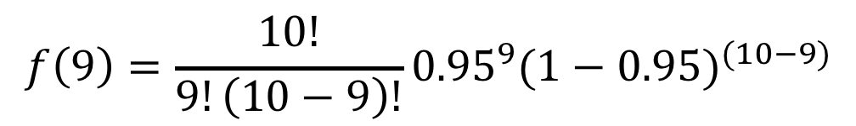
Example : Automotive part
Probability of success, p = 0.95
The number of trials, n = 10
x = 9
Using BINOMDIST function in Excel
BINOMDIST(x, n, p, Cumulative?)
BINOMDIST(9,10,0.95,0) = 0.315
$$f\left(9\right)=\frac{10!}{9!\left(10−9\right)!}{0.95}^{9}(1−0.95)^{(10−9)}$$

Slide 88
Cumulative ?
Cumulative distribution function, CDF(x)
Probability that the random variable, X will take a value less than or equal to x.
Probability that the number of non-defective items is 9 or less ?
CDF(9) = f(0)+f(1)+f(2)+…+f(9)
BINOMDIST(9,10,0.95,1) = 0.401

Slide 89
Binomial Distribution
Mean, E(X)= 𝜇 = np
Variance, 𝜎² = np(1-p)
Standard Deviation, = √ np(1-p)

Slide 90
Challenge
The company needs to supply 100 items.
What is the minimum number of item the company should produce, in order to get at least 100 non-defective items with probability 95% or higher?
What would be the smallest n , to make CDF(100) ≥ 0.95

Slide 91
Continuous Probability Distribution

Slide 92
Continuous Random Variable
Any value in an interval or a collection of intervals on the real number line.
Probability that the variable takes a particular number will be zero. P(x = 13.456843237890…) = 0
The probability of continuous random variable is defined for an interval. P(0≤ x ≤ 3.5) = 0.34

Slide 93
Probability Density Function
Shows the frequencies, f (x) of all values of the random variables, x
PDF, f (x) is NOT probability.
Properties of the probability density function
∫ f (x)dx = 1 , f (x) ≥ 0
f (x)
x

Slide 94

Probability of Continuous Random Variable
The Probability is the area under the curve
f (x)
x₁
x₂

Slide 95
Normal Distribution

Slide 96
Normal Distribution
Describe many continuous random variables
Can be used as an approximation of some discrete probability distributions : Central Limit Theorem
Basic for classical statistical inference

Slide 97
Characteristics of Normal Distribution
Bell-shaped and Symmetric curve
Mean=Median = Mode
Infinite range

Slide 98
Normal Probability Density Function
Normal Probability Density Function
where,
x = value of random variable
𝜇 = mean
𝜎 = standard deviation
𝜋 = 3.14159
e = 2.71828

Slide 99
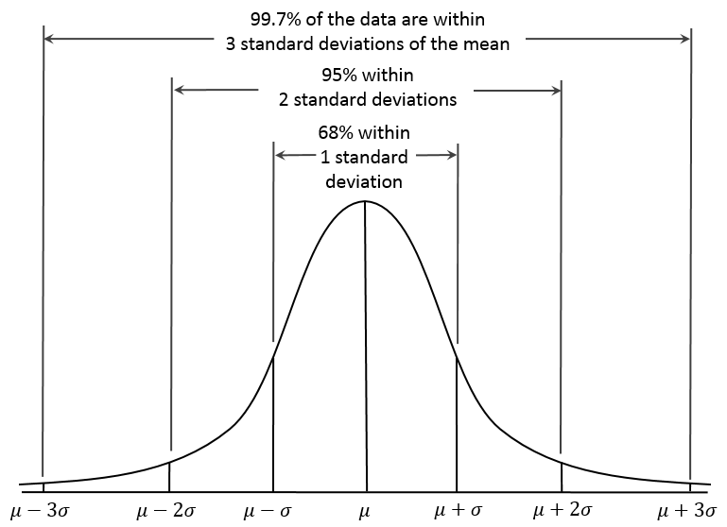
Common intervals of Normal Distribution
By Dan Kernler - Own work, CC BY-SA 4.0, https://commons.wikimedia.org/w/index.php?curid=36506025

Slide 100
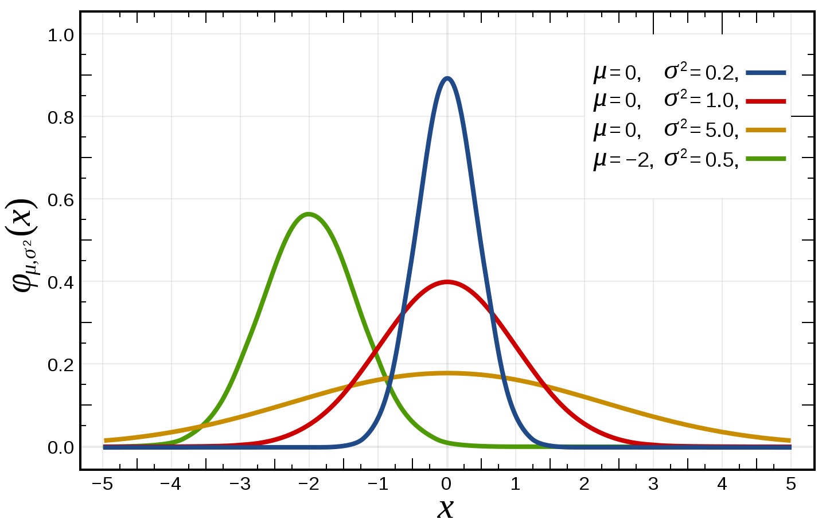
Parameters of Normal distribution

Slide 102
Standard Normal & z value

Slide 103
Standard Normal Distribution and z-value
Standard Normal : Normal distribution with 𝜇= 0, 𝜎 = 1
z-value : the distance from the mean, measured by standard deviation.
For example, when 𝜇 = 120, 𝜎 = 15
In z-value, x = 150 is +2 = (150-120)/15
This means 150 is located from the mean by 2 𝜎 away in +direction.

Slide 104
Converting to Standard Normal Distribution
𝜎 = 2
𝜎 = 1
𝜇=7
x=8.5
𝜇=0
z=8.5

Slide 105
Why Standardization?
𝜎 = 2
𝜎 = 1
𝜇=7
x=8.5
𝜇=0
z=8.5
P(7 ≤ x ≤ 8.5) = P(0 ≤ x_{st} ≤ 0.75)

Slide 106
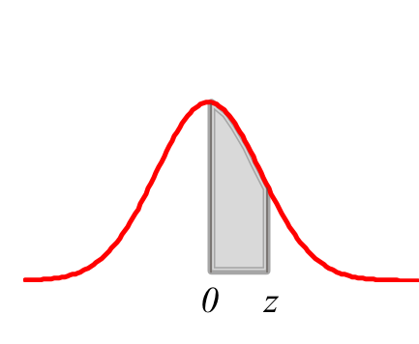
Standard Normal Probability Table
P (0 ≤ x_{st} ≤ 0.75) = 0.2734
z | 0.00 | 0.01 | 0.02 | 0.03 | 0.04 | 0.05 | 0.06 | 0.07 | 0.08 | 0.09
0.0 | 0.0000 | 0.0040 | 0.0080 | 0.0120 | 0.0160 | 0.0199 | 0.0239 | 0.0279 | 0.0319 | 0.0359
0.1 | 0.0398 | 0.0438 | 0.0478 | 0.0517 | 0.0557 | 0.0596 | 0.0636 | 0.0675 | 0.0714 | 0.0753
0.2 | 0.0793 | 0.0832 | 0.0871 | 0.0910 | 0.0948 | 0.0987 | 0.1026 | 0.1064 | 0.1103 | 0.1141
0.3 | 0.1179 | 0.1217 | 0.1255 | 0.1293 | 0.1331 | 0.1368 | 0.1406 | 0.1443 | 0.1480 | 0.1517
0.4 | 0.1554 | 0.1591 | 0.1628 | 0.1664 | 0.1700 | 0.1736 | 0.1772 | 0.1808 | 0.1844 | 0.1879
0.5 | 0.1915 | 0.1950 | 0.1985 | 0.2019 | 0.2054 | 0.2088 | 0.2123 | 0.2157 | 0.2190 | 0.2224
0.6 | 0.2257 | 0.2291 | 0.2324 | 0.2357 | 0.2389 | 0.2422 | 0.2454 | 0.2486 | 0.2517 | 0.2549
0.7 | 0.2580 | 0.2611 | 0.2642 | 0.2673 | 0.2704 | 0.2734 | 0.2764 | 0.2794 | 0.2823 | 0.2852
0.8 | 0.2881 | 0.2910 | 0.2939 | 0.2967 | 0.2995 | 0.3023 | 0.3051 | 0.3078 | 0.3106 | 0.3133
0.9 | 0.3159 | 0.3186 | 0.3212 | 0.3238 | 0.3264 | 0.3289 | 0.3315 | 0.3340 | 0.3365 | 0.3389
1.0 | 0.3413 | 0.3438 | 0.3461 | 0.3485 | 0.3508 | 0.3531 | 0.3554 | 0.3577 | 0.3599 | 0.3621

Slide 107
Using Table to Find Probability
First Standardize, and look up the table
𝜇=12, 𝜎= 1.2
P(12 ≤ x ≤ 13) =

Slide 108
Challenge : Z Table
𝜇 = 12, 𝜎 = 1.2
P(10.8 ≤ x ≤ 13) =
(Hint: Normal distribution is symmetric)

Slide 109
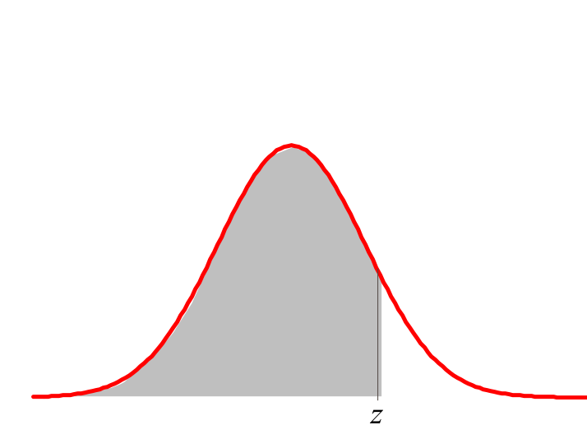
Using Excel Functions
Cumulative
P(X ≤ x) = NORMDIST(x, 𝜇, 𝜎, 1)
Find z given x
z = STANDARDIZE(x, 𝜇, 𝜎) = (x - 𝜇)/ 𝜎
Find z value given probability
z = NORMINV(p, 𝜇, 𝜎)

Slide 110
Example : Normal distribution

Slide 111
Draft Beer Demand
ABC pub sells draft beer.
ABC orders draft beer when the stock of beer drops to 30 gallons and the delivery takes 5 days.
The demand during 5 days is normally distributed with 𝜇=24, 𝜎 = 8
The manager of the pub, would like to know the probability of a stockout, P(X>30), and want to lower the probability of stockout.

Slide 112
Probability of stock out
X ~ Normal with 𝜇 = 24, 𝜎 = 8
Probability of stock out P(X >30)

Slide 113
Decrease the probability of stockout.
If the manager want to decrease the probability of stockout to 10% (0.1), How much beer should be kept when the pub places an order?

Slide 114
Law of Large Number & Central Limit Theorem

Slide 115
Central Limit Theorem
This is what makes Normal distribution so popular.
“When independent random variables are added, their properly normalized sum tends toward a normal distribution even if the original variables themselves are not normally distributed.” (Wikipedia)

Slide 116
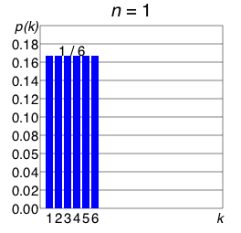
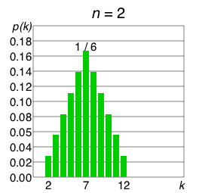
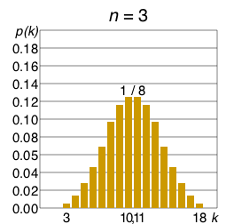
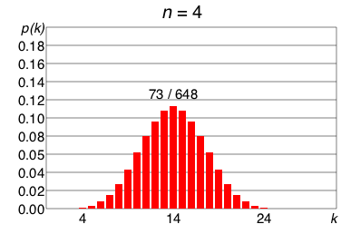
Central Limit Theorem
Probability distributions of the sum of n dice
By Cmglee - Own work, CC BY-SA 3.0, https://commons.wikimedia.org/w/index.php?curid=18918612

Slide 117
Law of Large Number
An average of large number of observations would be more accurate than that of small number of observation.
As n → ∞,
where 𝜇 is the true / theoretical mean

Slide 118
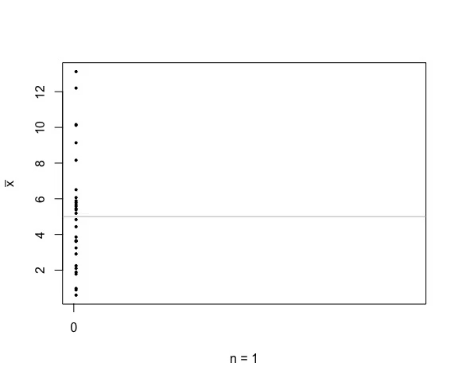
Demonstration of Law of Large Number
True Mean, 𝜇 = 5
https://yihui.name/animation/

